Slide 1

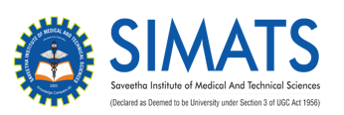
AI-Enabled Disaster Preparedness, Emergency Response and Community Assistance System CSA1101-Object Oriented Analysis and Design
Presented by-
M.VISHNU PRASAD
MATHU SRI
RAJASRI
SRUTHI

Slide 2


Introduction
Natural disasters can occur unexpectedly. Quick response is important to save lives.
AI can help predict disasters and support emergency decisions.
This system connects authorities, rescue teams, and affected communities.
(e.g., hospitals, shelters, food, water, and medical support)
The system provides early warnings and emergency alerts to people in risk areas.
The main goal is to reduce disaster impact, improve response time, and help rescue teams identify and prioritize affected people quickly.

Slide 3
Problem Statement
Disaster warnings are often delayed or difficult to access.
Emergency teams may face difficulty locating affected people.
Communication between victims, rescue teams, and authorities can be slow.
Limited resources such as food, medicine, shelters, and rescue vehicles may not be distributed efficiently.
There is a need for an AI-based system for faster, smarter, and coordinated disaster management.

Slide 4
Proposed System
An AI-powered system for disaster prediction and management.
Collects and analyzes real-time data to identify disaster risks.
Sends early warnings and emergency alerts to affected communities.
Helps rescue teams locate and prioritize emergency cases.
Provides information about nearby hospitals, shelters, food, water, and other resources.

Slide 5
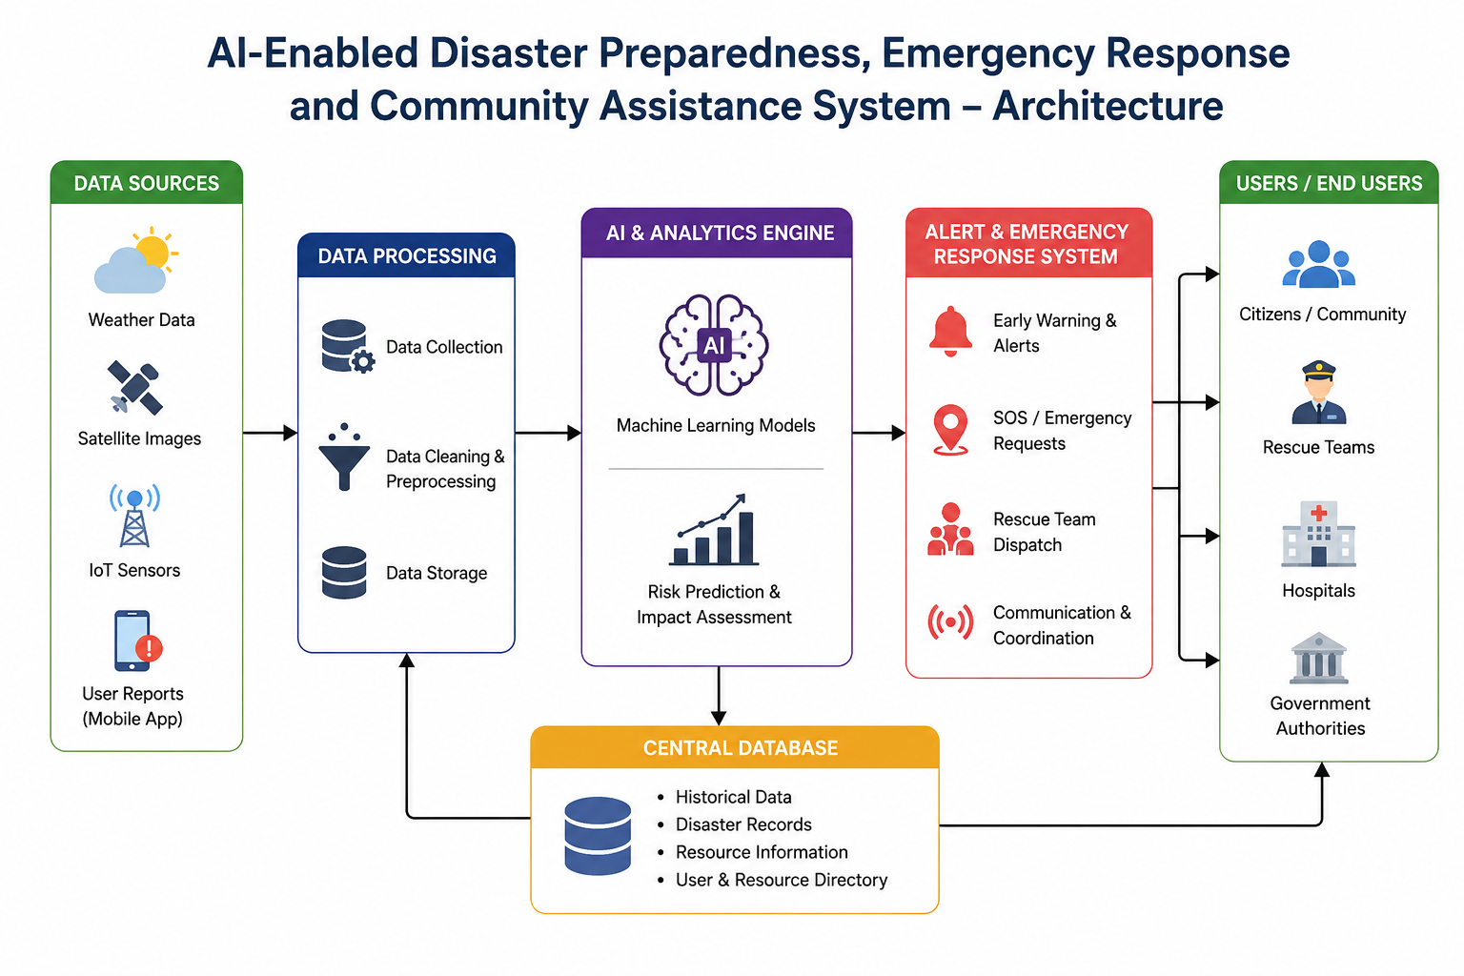
Architecture

Slide 6
THANK
YOU

